Slide 1

Department of Information Technology Minor Project review 2 SMART HOME USING IOT IN CLOUD COMPUTING
Guided by:- Presented by:-
Dr. C MAHESH SUMANT KUMAR(16155)
M.E.,Ph.D. SAHIL SINHA(15261)
HOD IT T.VEDANSHU RAJ(16151)
https://www.veltech.edu.in

Slide 2
INDEX
Objective
Introduction
Problem Statement
Literature Survey
Title Explanation
Architecture
Data Flow Diagram
Existing System
ER Diagram
Proposed System
Module
Feasibility Of Project
Conclusion
Reference

Slide 3

Objective
Aim of the Project:
The main objective of the functions is to improve the quality of life and convenience in the home.
Other goals are greater security and more efficient use of energy thanks to connected, remote-controllable devices.
Scope of the Project:
The scope of the project is to control the home security and digitalized home.

Slide 4
Introduction
Smart Home (SH) promises the potentials for the user to measure home conditions (e.g., humidity, temperature, luminosity, etc.), manipulate home HVAC (heating, ventilation and air conditioning) appliances and control their status with minimum user's intervention. Researchers and practitioners have made a great deal of efforts in facilitating the concept.
The aforementioned research efforts focus on the SH features of context-awareness, energy efficiency, natural interaction, and user activity recognition.
Several articles are found that develop and apply IoT solutions based on the existing clouds that are matter of study in this paper. Strong need for integration of cloud and IoT is mentioned in where an agent oriented and cloud assisted paradigm is envisaged based on a novel reference

Slide 5
Problem statement
While switching on/off home appliances we generally uses switches in which chances of short circuit is high.
If we went outside the home and forget to switch off the lights and fans, then it will leads to unusual consumption of electricity.
To overcome such situation, we can switch on/off the particular appliances by just one tap from our phone or system.

Slide 6
Literature review
S.No | Authour | year | Proposed technique | Pros and cons
1 | Soni, D., & Makwana | April, 2020 | MQTT (Message Queuing Telemetry Transport) | monitoring and controlling room temperatures
2 | Huang, F. L., Liao, Z. Z., Wang, T. H., Chen, Q. M., Wu, T. H., & Chang, C. H. | July,2021 | Intelligent and Disaster Prevention Hard Hat Based on AIOT and Speeches Recognition | provide accurate evidence of personal identity
3 | Maw, H. M., Thu, S. M., & Mon, M. T. | November, 2021 | Face Recognition based on Illumination Invariant Techniques Model. | it is easy to use with available cam embedded in computers and smartphones

Slide 7
Literature review(Cont..)
S.No | Authour | year | Proposed technique | Pros and cons
4 | Ray, P. P. | 2021 | MQTT broker | provides a connecting link between physical devices and smart home systems

Slide 8
Title explanation
S.no | Item | Description
1 | Base paper title | SMART HOME SYSTEM
2 | Proposed project title | SMART HOME USING IOT IN CLOUD COMPUTING
3 | Improvement from existing method | With the addition of cloud computing a user can store it’s data to a cloud server.

Slide 9
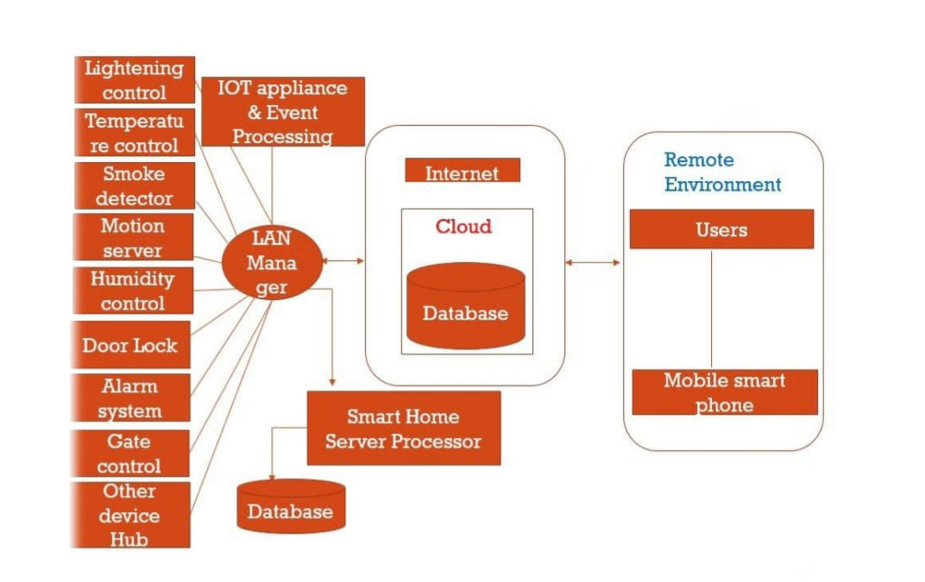
Architecture

Slide 10
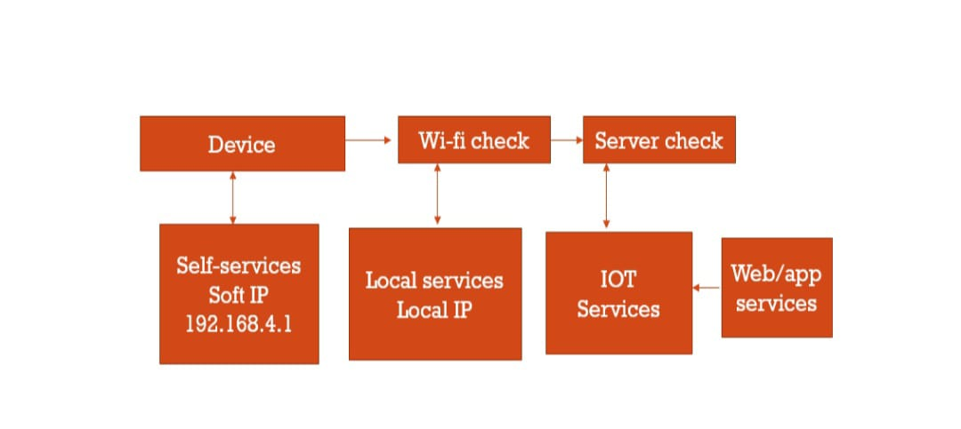
Data Flow Diagram

Slide 11
Existing system
Lightning control system that is use to control the light of the home with the help of light intensity meter known as light meter.
Amazon Echo(4th Gen) perform specific task when it is being instructed by the user.

Slide 12
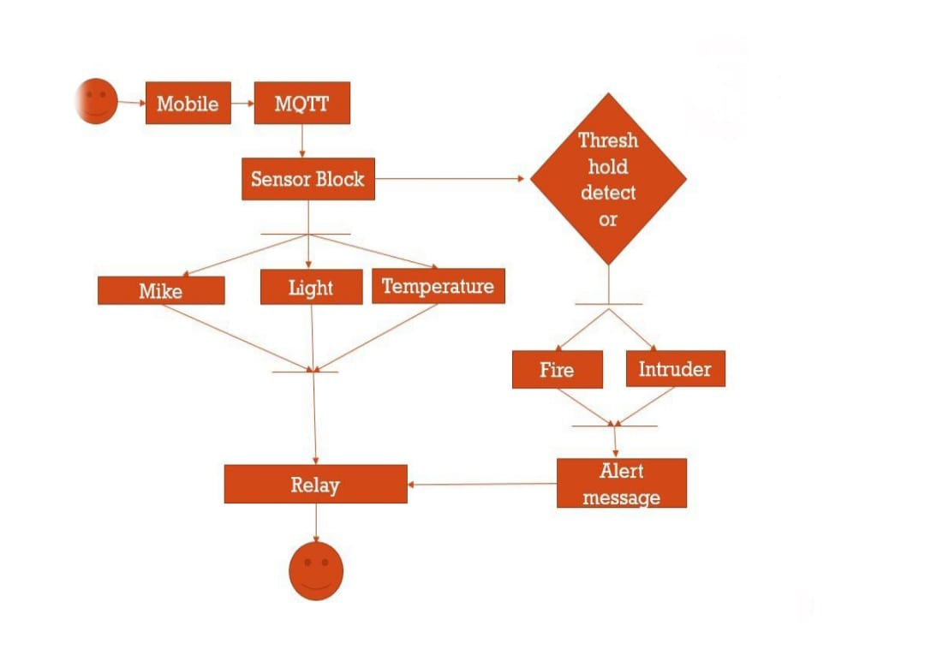
ER Diagram

Slide 13
Proposed system
Smart home appliance(eg. Light,Fan,Tv etc..) can be accessed with the help of mobile phone or system in just one click.
Pros:-
It provides reliability and reduced power consumption.
Cons:-
To store data that it requires a cloud storage that is expensive in cost.

Slide 14
MODULES
Humidity sensor: These sensors bring the capability of sensing humidity/RH levels in air for smart homes. The accuracy and sensing precision depends a lot on multiple factors including the overall sensor design and placement.
Security: Systems like lock or TP-Link camera for household security are the usual part of a connected home kit. Enhanced security is a smart home benefit early adopters favor the most. However, smart locks and surveillance cameras are not the only tools to improve the security of households.
Sound Detection For Home Automation: Sound detection plays a vital role from monitoring babies to turning on and off lights automatically to automatically detecting your dog’s sound at the door and opening it up for them.

Slide 15
Temperature Sensors: The temperature sensor collects the neighboring temperature data, first the temperature sensor LM-35 gathers the temperature in the environment in form of analog signals. It gathers the temperature in degree Celsius measurements. Then the Arduino UNO controller via a connection wire receives the input of temperature from the temperature sensor LM-35. The sensor collects the surrounding temperature value with an accuracy of 70%. The controller then converts the analog input received from temperature sensor and show digitally in the screen.

Slide 16
Feasibility of project
The project can be easily built with all the available tools and resources.
It provides efficiency in time as well as reduce power consumption.
Dependency:-
Temperature sensor
Humidity sensor
Arduino
Wi-Fi Modular

Slide 17
Conclusion
In this paper different smart home based system with IOT systems services and their Features, Challenges and Security aspects are discussed. Internet (Wifi) based home system with IOT system is a flexible and low cost, such system can only work in the wireless network. Such systems are noise sensitive and their accuracy can be affected by signal to noise ratio. These data are uploaded from the gateway to the web server through the LAN. Data acquisition and transmission are coded in parallel processes. That is when data acquisition is operating, data transmission is not interrupted and is executed in the background. The approach was successfully used for demonstrating services for measuring home conditions, monitoring home appliances, and controlling home access.

Slide 18
Reference
El-Hajj, M.; Fadlallah, A.; Chamoun, M.; Serhrouchni, A. A Survey of Internet of Things (IoT) Authentication Schemes. Sensors 2019, 19, 1141. [Google Scholar]
Singh, U.; Ansari, M.A. Smart Home Automation System Using Internet of Things. In Proceedings of the 2019 2nd International Conference on Power Energy, Environment and Intelligent Control (PEEIC), Noida, India, 18–19 October 2019; pp. 144–149. [Google Scholar]
Malche T, Maheshwary P (2017) Internet of things (IoT) for building smart home system. In: International conference on I-SMAC, IoT in social, mobile, analytics and cloud, I-SMAC 2017Google Scholar

Slide 19
THANK YOU

